Slide 1
Machine Learning to Deep Learning
Tutorial code: https://github.com/leejaymin/TensorFlowLecture
2017. 04. 20
Jemin Lee (leejaymin@cnu.ac.kr)
Hompage: https://leejaymin.github.io/index.html
Notes:
역사
알고리즘 약간은 깊이 있는 이해
그것을 통한 실제 구현 과 응용
시스템 Area에서의 Deep-Learning

Slide 2
머신 러닝
(Machine Learning)

Slide 3
머신러닝이란
“머신 러닝 또는 기계 학습은 인공 지능의 한 분야로, 컴퓨터가 학습할 수 있도록 하는 알고리즘과 기술을 개발하는 분야를 말한다.” - 위키피디아
“Field of study that gives computers the ability to learn without being explicitly programmed.” - Arthur Samuel, 1959
출처: 해커에게 전해들은 머신러닝, 한빛미디어 리얼타임 세미나
Notes:
데이터 마이닝은 지식이나 인사이트를 얻는다.
머신러닝은 새로운 데이터를 처리하는 데 촛점을 맞추므로 어떻게 해결되었는 지 적절하게 설명하기 어려울 수 있다.

Slide 4
리소스 분류
Computer
Science
Statistics
확률
Statistical ML
인공지능
회귀
뉴럴 네트워크
베이지안 네트워크
컴퓨터 비전
Machine
Learning
자연어처리
추천
패턴인식
연관분석
빅데이터
Data Mining
출처: 해커에게 전해들은 머신러닝, 한빛미디어 리얼타임 세미나
Notes:
통계학의 알고리즘에 많이 의존함.
통계학적 머신러닝이라고 부르기도 함.
컴퓨터 과학에 좀 더 실용적 접근이 많음.

Slide 5
$$AI⊃Machine Learning⊃Deep Learning$$
출처: 해커에게 전해들은 머신러닝, 한빛미디어 리얼타임 세미나
Notes:
AI는 언어학, 뇌의학, 검색, 로봇틱스 포함
아직 일반지능이 아님
딥러닝은 뉴럴 네트워크를 사용한 머신러닝

Slide 6
시간에 따른 변화
출처: 해커에게 전해들은 머신러닝, 한빛미디어 리얼타임 세미나
Notes:
2012년 제프리힌튼 팀의 이미지 분류 논문(ImageNet Classification with Deep Convolutional Neural Networks)

Slide 7
머신러닝 분류

Slide 8
학습 방법
지도학습, 감독학습
비지도학습, 비감독학습
강화학습
출처: 해커에게 전해들은 머신러닝, 한빛미디어 리얼타임 세미나
Notes:
훈련데이터/학습데이터
지도학습: 주가예측, 스팸메일 분류
비지도학습: 고객 분류
딥 러닝은 알고리즘의 하나로 학습방법이 아님.
딥 리인포스먼트 러닝

Slide 9
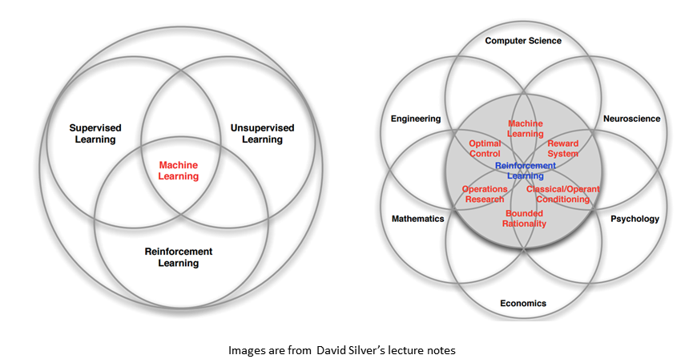

Slide 10
Table of Contents
Fundamental Machine Learning
Linear Regression: Gradient Descent Algorithm (optimization)
Logistic Regression (Single Neuron=Perceptron): Sigmoid (Logistic function), Convexity, Cross Entropy, Decision Boundary
Multiple Perceptron (Hidden Layer): Backpropagation algorithm
Deep Neural Network Breakthrough
Rebirth of Neural Network, renamed DNN
DNN, ReLU, Pre-training, Dropout
Convolutional Neural Network (CNN)
Recurrent Neural Network (RNN)

Slide 11
Linear Regression: 이론
Gradient Descent

Slide 12
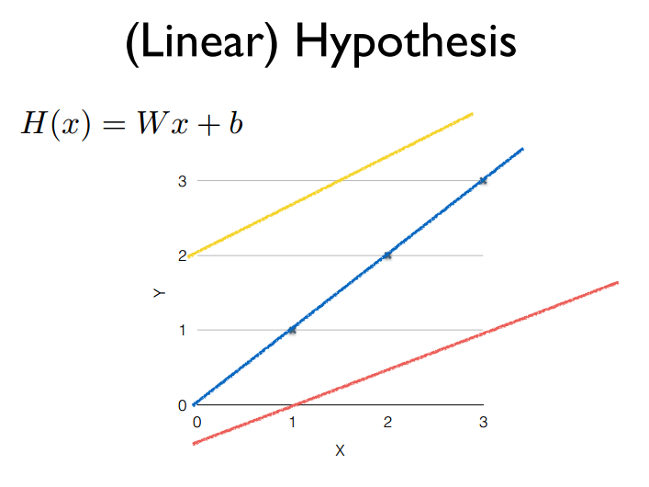
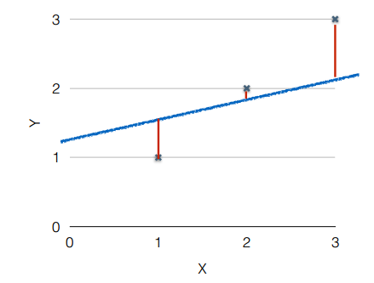
Which hypothesis is better
출처: 모두를 위한 머신러닝 시즌1, 김성훈 교수님

Slide 13
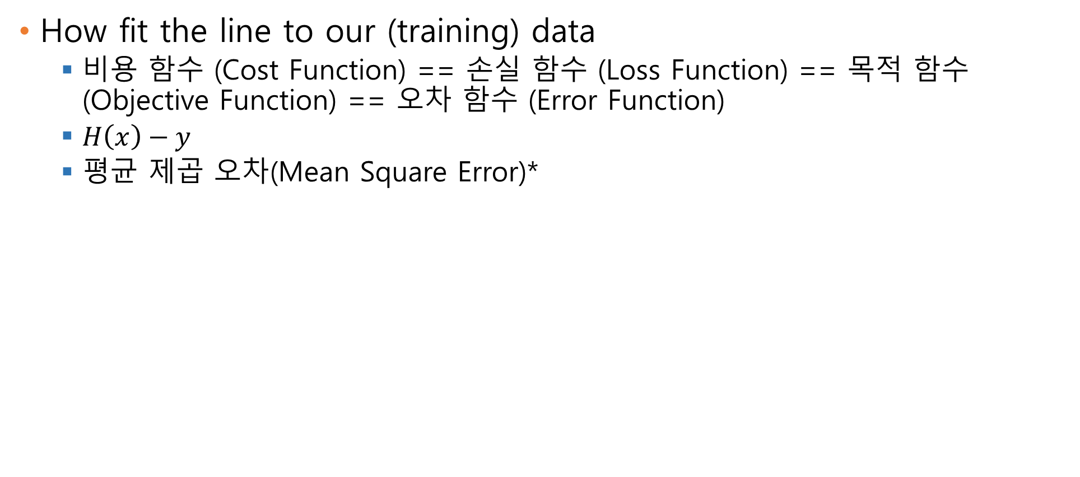
Cost function[1/2]
How fit the line to our (training) data
비용 함수 (Cost Function) == 손실 함수 (Loss Function) == 목적 함수 (Objective Function) == 오차 함수 (Error Function)
$H\left(x\right)−y$
평균 제곱 오차(Mean Square Error)*
오차의 제곱
미분후 깔끔을 위해 2로 나눔
모든 훈련 데이터의
오차 제곱을 더함
훈련 데이터
갯수로 나눔

Slide 14
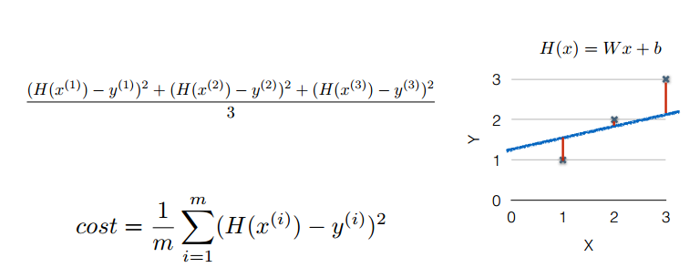
Cost function[2/2]
출처: 모두를 위한 머신러닝 시즌1, 김성훈 교수님

Slide 15
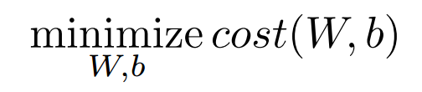
Goal: Minimize cost
출처: 모두를 위한 머신러닝 시즌1, 김성훈 교수님

Slide 16
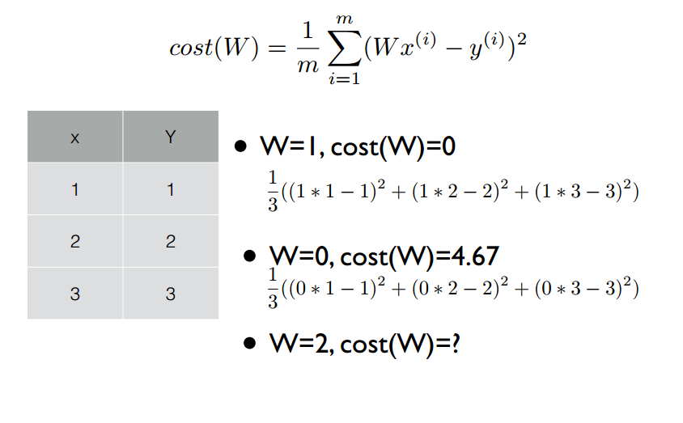
Gradient Descent Algorithm
출처: 모두를 위한 머신러닝 시즌1, 김성훈 교수님

Slide 17
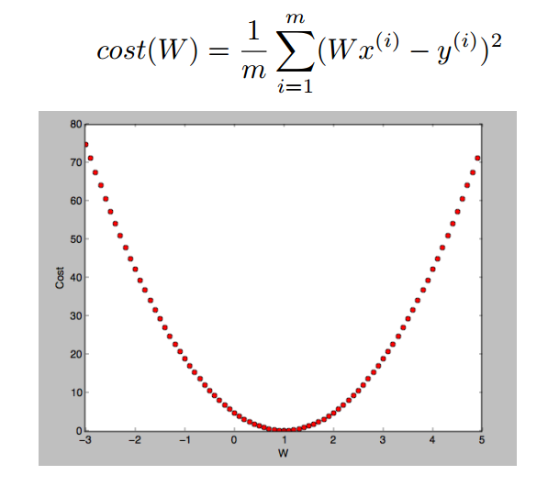
Gradient Descent Algorithm
Minimize cost function
For a given cost function, Cost(W,b), it will find W,b to minimize cost
It can be applied to more general function: cost(w1, w2,…)
Where you start can determine which minimum you end up
Perfect convexity
출처: 모두를 위한 머신러닝 시즌1, 김성훈 교수님

Slide 18
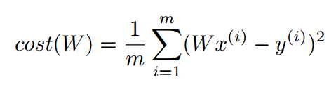
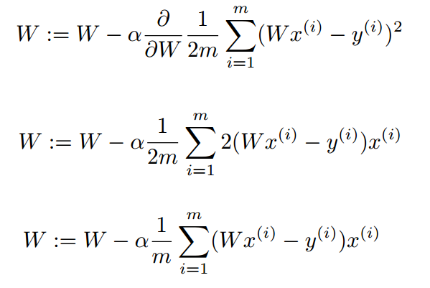
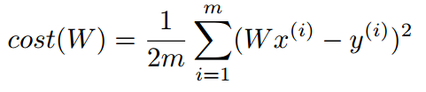
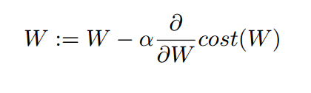
Formal definition
출처: 모두를 위한 머신러닝 시즌1, 김성훈 교수님

Slide 19
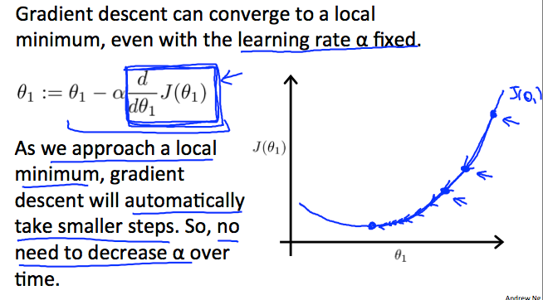
Gradient Descent Intuition[1/2]
Coursera, Machine Learning, Andrew Ng

Slide 20
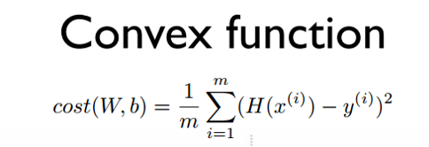
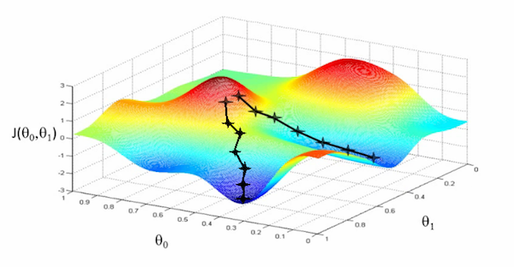
Gradient Descent Intuition[2/2]
Coursera, Machine Learning, Andrew Ng

Slide 21
Linear Regression: 예제

Slide 22
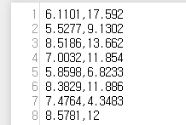
Linear Regression with One Variable
Suppose you are the CEO of restaurant franchise and are considering different cities for opening a new branch.
You'd like to use this data to help you select which city to expand to next.
The file ex1data1.txt contains the dataset for our linear regression problem.
The first column is the population of a city and the second column is the profit of a food truck in that city.
A negative value for profit indicates loss.
Coursera, Machine Learning, Andrew Ng

Slide 23
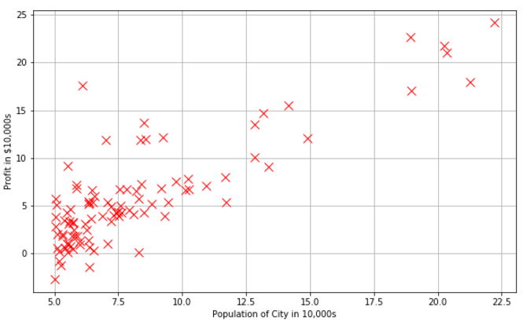
Data distribution

Slide 24
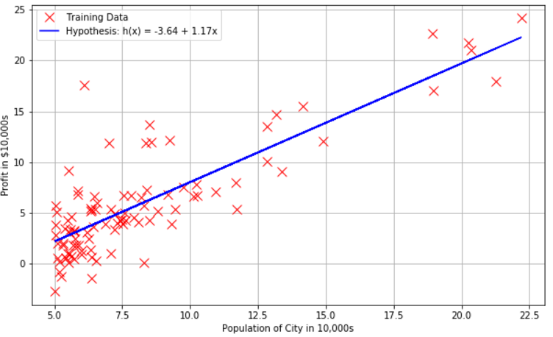
Regression result

Slide 25
하나의 뉴런
(Single Neuron, Perceptron, Logistic Regression)

Slide 26
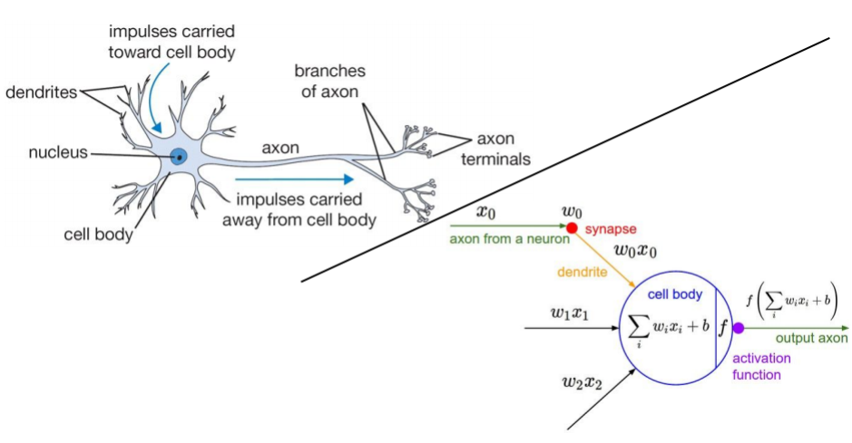
Perceptron(2/2)
http://cs231n.stanford.edu/slides/winter1516_lecture4.pdf

Slide 27
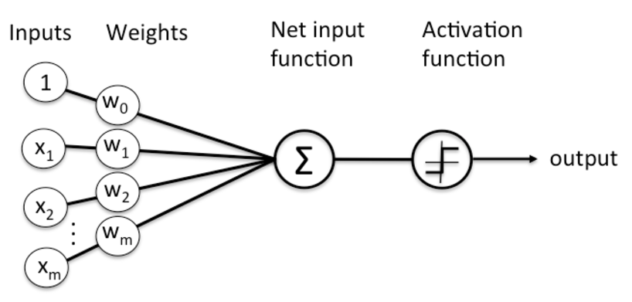
Perceptron(2/2)
출처: 해커에게 전해들은 머신러닝, 한빛미디어 리얼타임 세미나

Slide 28
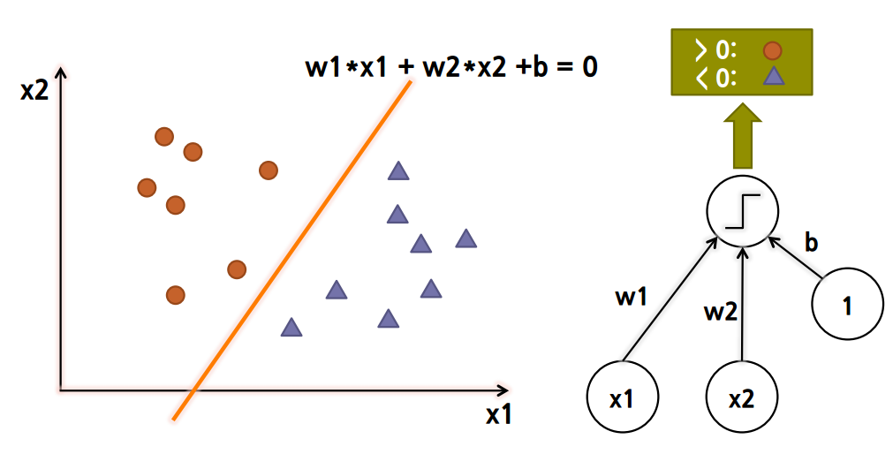
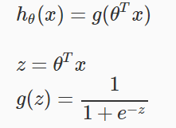
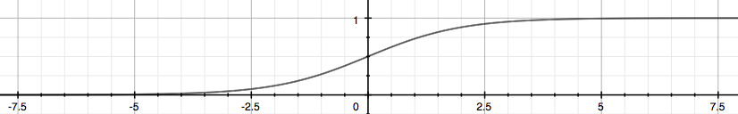
Decision Boundary
> 0.5: circle
< 0.5: triangle

Slide 29
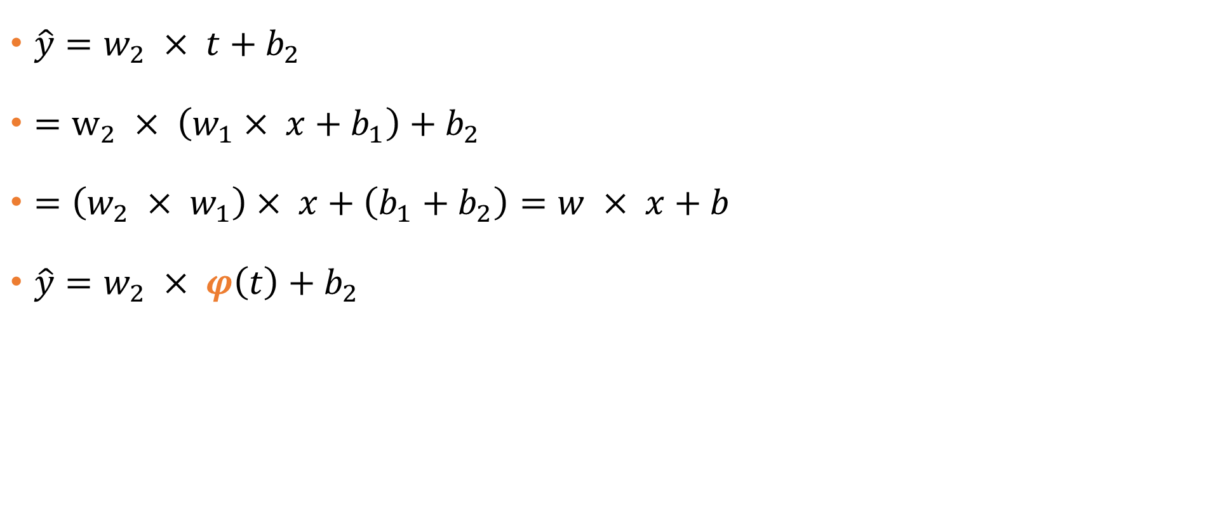
왜 비선형 함수 Sigmoid이 필요한가?
$\hat{y}=w_{2} × t+b_{2}$
$=w_{2} × \left(w_{1}× x+b_{1}\right)+b_{2}$
$=\left(w_{2} × w_{1}\right)× x+\left(b_{1}+b_{2}\right)=w × x+b$
$\hat{y}=w_{2} × φ\left(t\right)+b_{2}$
미분가능한 비선형함수: 시그모이드(Sigmoid), 렐루(ReLU),
하이퍼볼릭탄젠트(tanh)
출처: 해커에게 전해들은 머신러닝, 한빛미디어 리얼타임 세미나

Slide 30
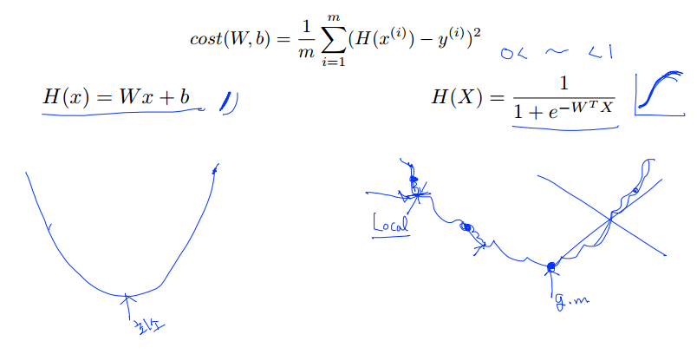
Cost Function: Cross Entropy[1/2]

Slide 31
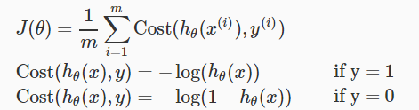
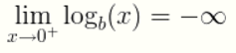
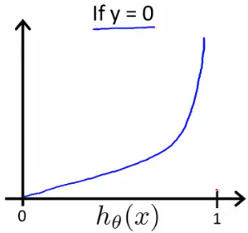
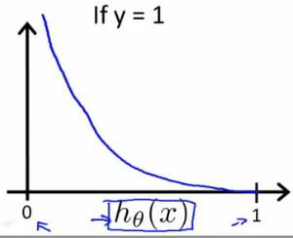
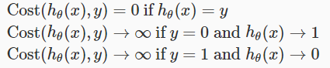
Cost Function: Cross Entropy[2/2]
새로운 Cost Function
Coursera, Machine Learning, Andrew Ng

Slide 32
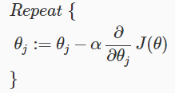
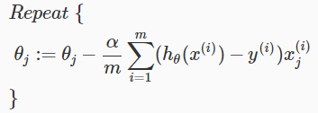
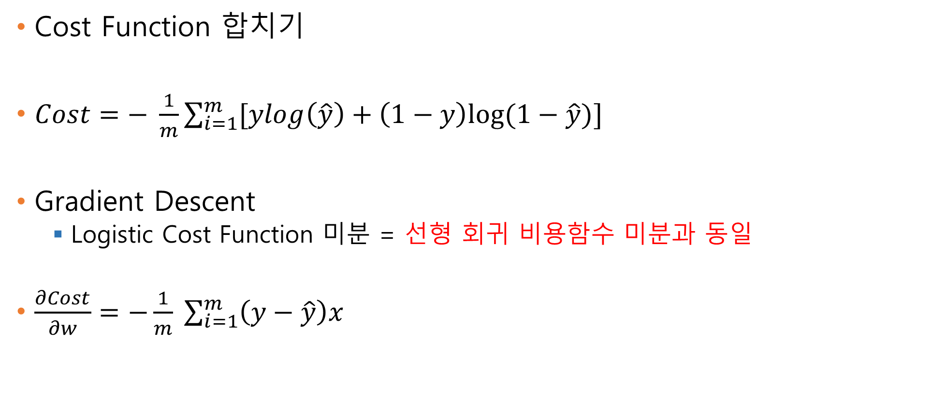
Cross Entropy and Gradient Descent
Cost Function 합치기
$Cost=− \frac{1}{m}\sum_{i=1}^{m}{[ylog\left(\hat{y}\right)+\left(1−y\right)log⁡(1−\hat{y})]}$
Gradient Descent
Logistic Cost Function 미분 = 선형 회귀 비용함수 미분과 동일
$\frac{∂Cost}{∂w}=−\frac{1}{m} \sum_{i=1}^{m}{\left(y−\hat{y}\right)x}$
Coursera, Machine Learning, Andrew Ng

Slide 33
하나의 뉴런: 예제

Slide 34
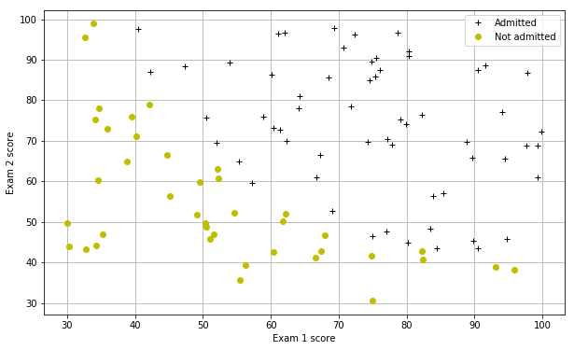
해결하고자 하는 문제
학생들이 대학에 입학 할 수 있는지를 예측
과거 지원자의 두 과목 시험 점수와 결과
Ex: 100, 99 = 합격(1)
50, 70 = 불합격(0)
코드 위치
https://github.com/leejaymin/TensorFlowLecture/blob/master/0.1.Fundamental_Neural_Network/ex2/ex2_jemin.ipynb
Coursera, Machine Learning, Andrew Ng

Slide 35
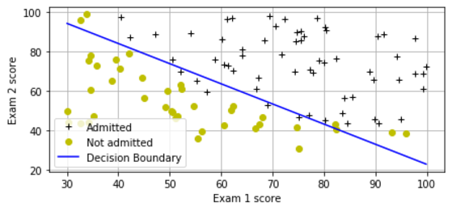
Result

Slide 36
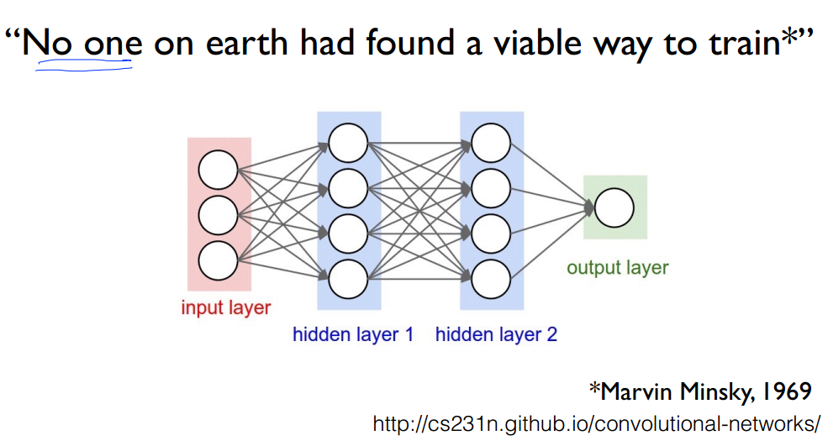
출처: 모두를 위한 머신러닝 시즌1, 김성훈 교수님

Slide 37
Multi-layer Neural Network
Multi-layer Perceptron: 이론
Backpropagation

Slide 38
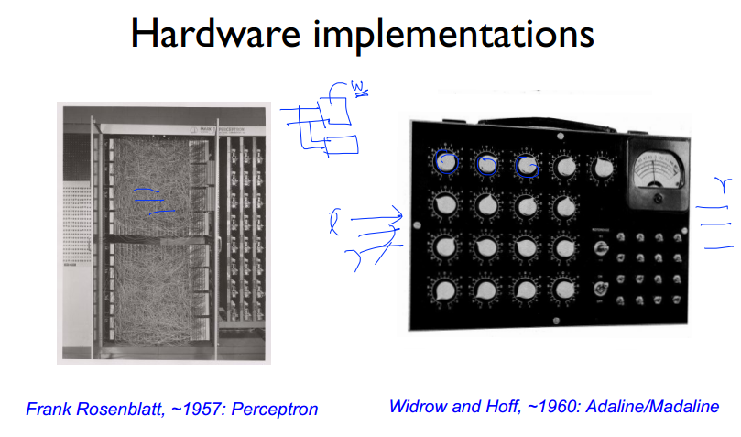
출처: 모두를 위한 머신러닝 시즌1, 김성훈 교수님

Slide 39
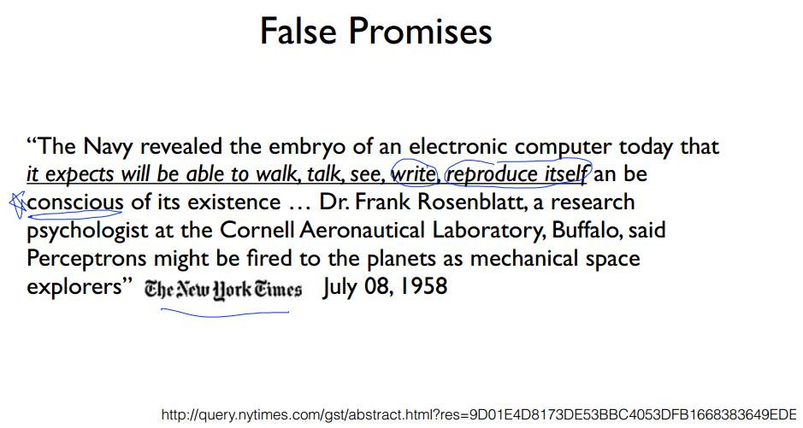
출처: 모두를 위한 머신러닝 시즌1, 김성훈 교수님

Slide 40
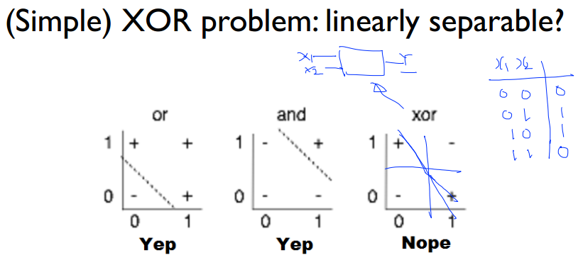
출처: 모두를 위한 머신러닝 시즌1, 김성훈 교수님

Slide 41
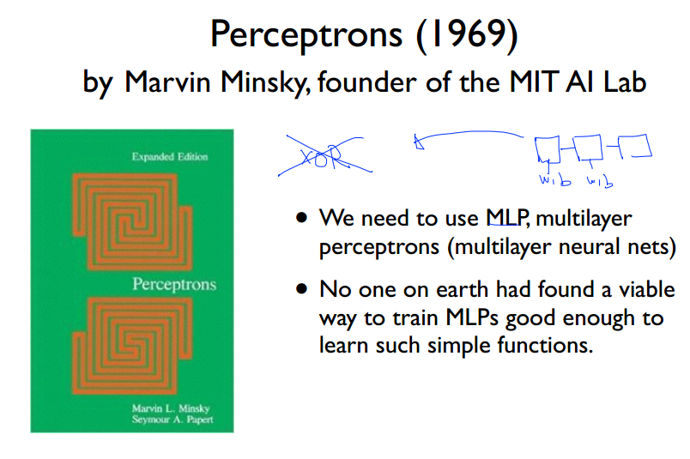
First Dark Age (1969~1986, 17)
출처: 모두를 위한 머신러닝 시즌1, 김성훈 교수님

Slide 42
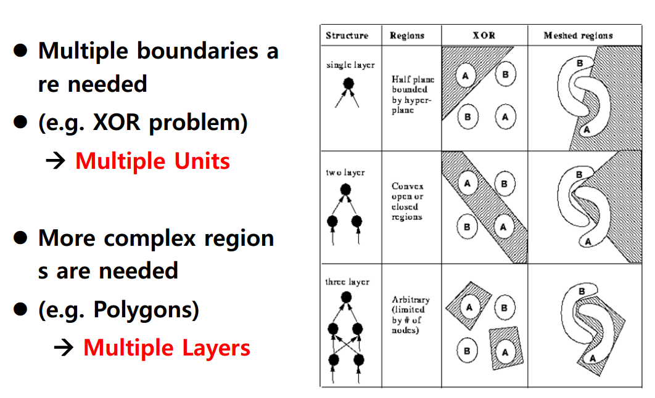

Slide 43
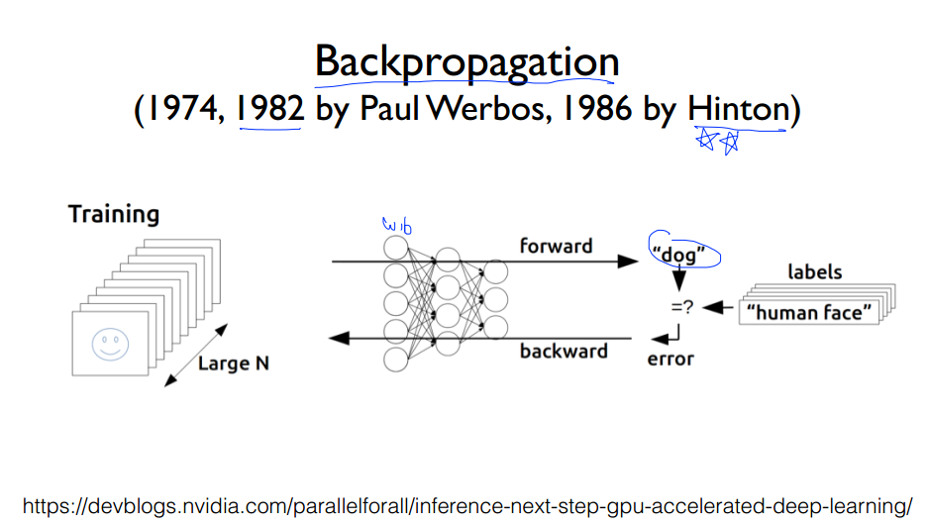
Neural-Network: 두 번째 봄 (Second Spring)

Slide 44
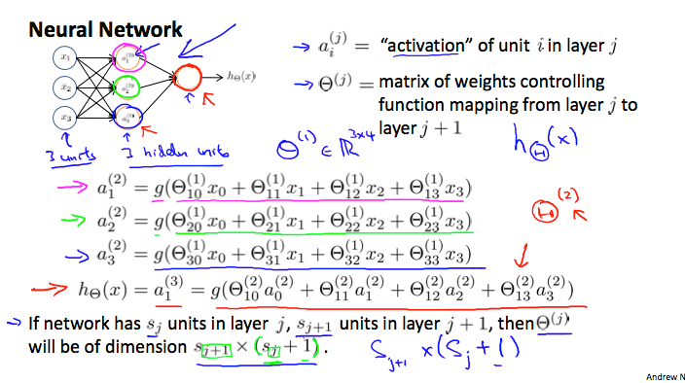
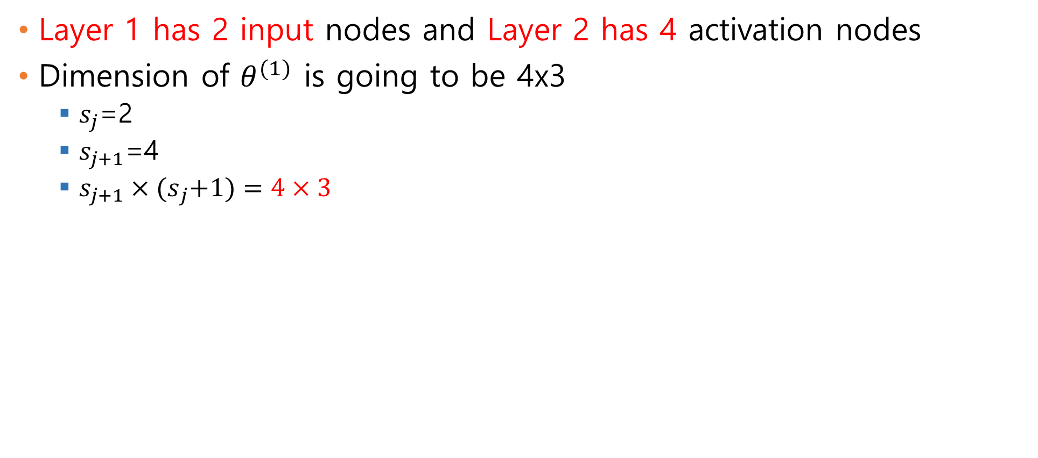
Neural Network Presentation[1/2]
Layer 1 has 2 input nodes and Layer 2 has 4 activation nodes
Dimension of $θ^{(1)}$ is going to be 4x3
$s_{j}$=2
$s_{j+1}$=4
$s_{j+1}×{(s}_{j}+1)=4×3$
Coursera, Machine Learning, Andrew Ng

Slide 45
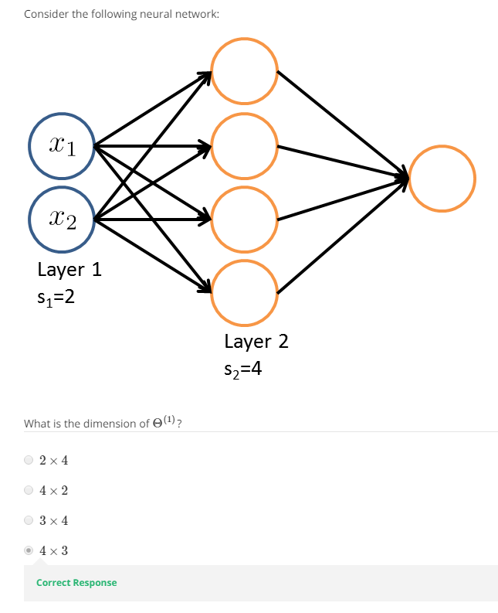
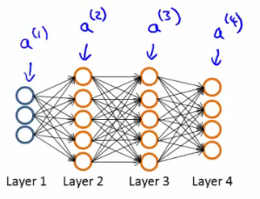
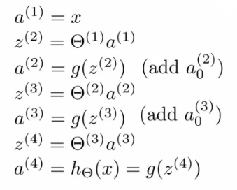
Neural Network Presentation[2/2]

Slide 46
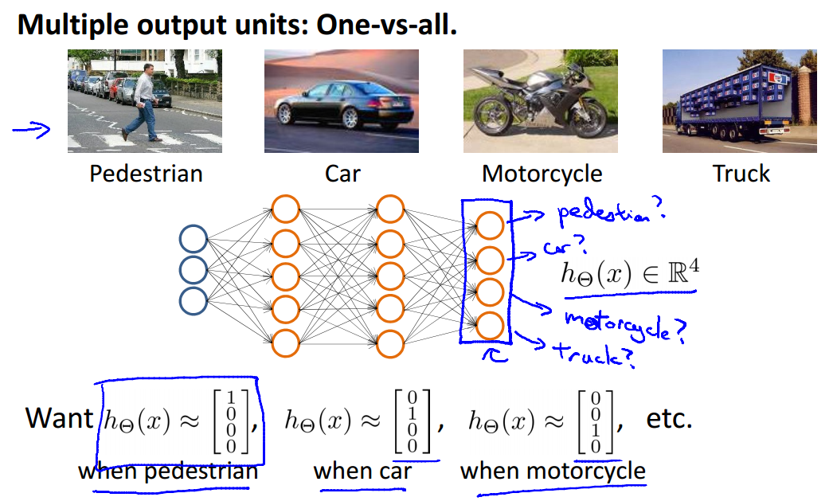
Coursera, Machine Learning, Andrew Ng

Slide 47
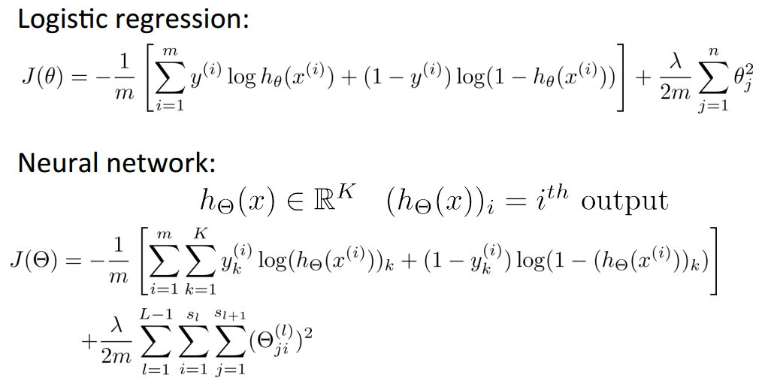
New Cost function
Coursera, Machine Learning, Andrew Ng

Slide 48
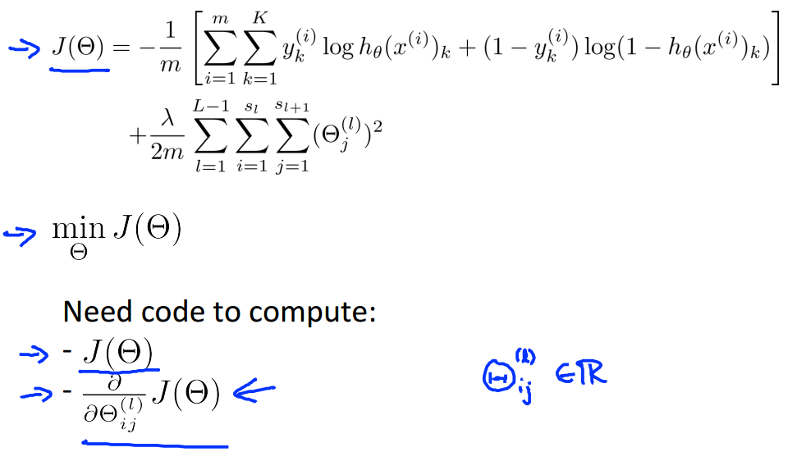
Backpropagation: gradient computation
Coursera, Machine Learning, Andrew Ng

Slide 49

딥러닝 6. Fully Connected Neural Network, 홍정모 교수님

Slide 50

딥러닝 6. Fully Connected Neural Network, 홍정모 교수님

Slide 51

딥러닝 6. Fully Connected Neural Network, 홍정모 교수님

Slide 52

동국대 홍정모 교수님, http://blog.naver.com/atelierjpro/220773276384

Slide 53
Multi-layer Perceptron: 예시

Slide 54


MNIST Database
Digit number data
Deep Learning, Top-guru, Yann LeCun, 뉴욕대 교수
학습 데이터 60,000
테스팅 데이터 10,000
전처리 완료 데이터 (size, label, color)
http://yann.lecun.com/exdb/mnist/
코드 위치
https://github.com/leejaymin/TensorFlowLecture/blob/master/0.1.Fundamental_Neural_Network/ex4/ex4_jemin.ipynb

Slide 55



Facebook AI Research (FAIR)

Slide 56


Slide 57

Neural Network Model
Three layer Neural Net.
Input layer= 20x20+1
Hidden layer= 25
Output layer= 10

Slide 58


Result
Training set accuracy: 97%

Slide 59
Go deeper: Deep Neural Network
a.k.a Deep Learning

Slide 60
Table of Contents
Fundamental Machine Learning
Linear Regression: Gradient Descent Algorithm (optimization)
Logistic Regression (Single Neuron=Perceptron): Sigmoid (Logistic function), Convexity, Cross Entropy, Decision Boundary
Multiple Perceptron (Hidden Layer): Backpropagation algorithm
Deep Neural Network Breakthrough
Rebirth of Neural Network, renamed DNN
DNN, ReLU, Pre-training, Dropout
Convolutional Neural Network (CNN)
Recurrent Neural Network (RNN)

Slide 61
A BIG problem
Backpropagation just did not work well for normal neural networks with many layers
Other rising machine Learning algorithms: SVM, Radom-Forest, EM, etc.
Statistical method
Chou-Fasman method ~ 50%
Nearest neighbors ~50~60%
Neural networks ~75% (Breakthrough!), 1986 (Dark age for 20 years)
Support Vector Machine (SVM) ~ 75%
HMM ~ 75%
Random Forest ~75%
Deep Learning ~88%, 2006 (rebirth of neural net. with big data).

Slide 62

Rebirth of Neural Network: Third Spring
포기하지 않는 연구: 20년간의 겨울 (1986-2016)
인공지능과 딥러닝 빅데이터 안고 부활

Slide 63



Deep Learning의 혁신[1/4]: Google Intern
Phonemes:
어떤 언어에서 의미 구별 기능을 갖는 음성상의 최소 단위

Slide 64

Deep Learning의 혁신[2/4]: Competition 우승

Slide 65

Deep Learning의 혁신[3/4]

Slide 66



Deep Learning의 혁신[4/4]
ImageNet Classification
Top-rank: Krizhevsky and hinton et al.(convent)
16.4% error (top-5)
Second-rank: Next best (non-convent)
26.2% error

Slide 67


Slide 68


Slide 69

문제점과 해결점
Algorithm적 문제
Solution
Vanishing Gradient -> ReLU (new activation function)
Local minimum problem -> pre-training, Restricted-Boltzmann-Machine(RBM), batch normalization (ICML’15)
Overfitting -> Dropout, Big-Data
Training Data의 부족
Solution
Smartphone
IoT
Computing Power 문제
Solution
GPGPU, NVIDA
Cloud Computing, AWS, Azure

Slide 70


Slide 71




Algorithm: Vanishing Gradient
Sigmoid의 도함수
$z=wx+b$
$g^{′}\left(z\right)=g\left(z\right)\left(1−g\left(z\right)\right)$
$g\left(z\right)= \frac{1}{1+exp⁡(−z)}$
0.25
Local Gradient의 Maximum이 0.25
Layer 1개를 지날 때마다 magnitude는 항상 one quarter 이하로 작아진다.
Yes you should understand backprop, Andrej Karpathy

Slide 72



Algorithm: Rectified linear Unit (ReLU)
ReLU
$f\left(x\right)=\left\{\begin{aligned}0, If x<0 \\ x, If x ≥0\end{aligned}\right.$
도함수
$f\left(x\right)=\left\{\begin{aligned}0, If x<0 \\ 1, If x ≥0\end{aligned}\right.$
ReLU
Sigmoid
Yes you should understand backprop, Andrej Karpathy

Slide 73


Algorithm: Restricted-Boltzmann-Machine(RBM)
즉, 이 모델은 RBM을 맨 아래 data layer부터 차근차근 stack으로 쌓아가면서 전체 parameter를 update하는 모델이다. 이 모델을 그림으로 표현하면 아래와 같은 그림이 된다.
Restricted Boltzmann Machines - Ep. 6 (Deep Learning SIMPLIFIED)

Slide 74

Algorithm: Restricted-Boltzmann-Machine(RBM)

Slide 75


Algorithm: Pre-training
No need to use complicated RBM for weight initializations
Simple methods are fine
Xavier initialization [1]
[1] Understanding the difficulty of training deep feedforward neural networks, 210

Slide 76

Weight Initialization
Truncated normal initialization 사용

Slide 77

Algorithm: Overfitting[1/2]
Dropout
It is an extremely effective, simple and recently introduced regularization technique by Srivastava et al [1].
While training, dropout is implemented by only keeping a neuron active with some probability p (a hyper-parameter), or setting it to zero otherwise.
[1] Journal of Machine Learning Research, Dropout: A Simple Way to Prevent Neural Networks from Overfitting

Slide 78

Algorithm: Overfitting[2/2]
BigData
Real Word == Collected Data
데이터가 많다면 Overfitting을 하는 경향은 최대의 장점이 된다.

Slide 79


Deep Learning의 혁신

Slide 80



NIPS 2015-2016
3755 attendees at NIPS2015! 1838 paper submissions, 1524 reviewers producing 10,625 reviews resulting in 403 papers (21.9%).
Only 20 oral talks are selected among 403 accepted papers (single-track). 7pm-12am (5hr) poster session every day.
https://twitter.com/Hassan_Sawaf/status/674012958981165056

Slide 81





Deep Learning’s Pioneers
Google Scholar 피인용 지수: Yann LeCun 44K, Geoffrey Hinton 160K, Yoshua Bengio 56K, Andrew Ng 72K
https://github.com/leehaesung/DeepLearningPioneers/wiki

Slide 82

TensorFlow playground
http://playground.tensorflow.org/

Slide 83

Deep Learning Framework

Slide 84

출처: 모두를 위한 머신러닝 시즌1, 김성훈 교수님

Slide 85

Coursera, Machine Learning, Andrew Ng

Slide 86

Diagnosing bias vs. variance
High Bias problem == underfitting
High variance problem == overfitting
Coursera, Machine Learning, Andrew Ng

Slide 87

Coursera, Machine Learning, Andrew Ng

Slide 88

Learning curves[1/3]
Coursera, Machine Learning, Andrew Ng

Slide 89

Learning curves[2/3]
Coursera, Machine Learning, Andrew Ng

Slide 90

Learning curves[3/3]
Coursera, Machine Learning, Andrew Ng

Slide 91



Summarized bias vs. variance
Coursera, Machine Learning,
Andrew Ng

Slide 92

Coursera, Machine Learning, Andrew Ng

Slide 93
Table of Contents
Fundamental Machine Learning
Linear Regression: Gradient Descent Algorithm (optimization)
Logistic Regression (Single Neuron=Perceptron): Sigmoid (Logistic function), Convexity, Cross Entropy, Decision Boundary
Multiple Perceptron (Hidden Layer): Backpropagation algorithm
Deep Neural Network Breakthrough
Rebirth of Neural Network, renamed DNN
DNN, ReLU, Pre-training, Dropout
Convolutional Neural Network (CNN)
Recurrent Neural Network (RNN)

Slide 94

Image Classification
A core task in Computer Vision
Assume given set of discrete lablels
{dog, cat, truck, plane, …}
Cat
CS231n: Convolutional Neural Networks for Visual Recognition

Slide 95

Challenges
Hard to classify labels
CS231n: Convolutional Neural Networks for Visual Recognition

Slide 96

Computer Vision Taksks
CS231n: Convolutional Neural Networks for Visual Recognition

Slide 97
Convolutional Neural Nets
이미지 분류
패턴 인식을 통해 기존 정보를 일반화하여 다른 환경의 이미지에 대해서도 잘 분류함. Sparse Connectivity 한 특징이 있음.
Lee Seungeun, CNN 초보자가 만드는 초보자 가이드 (VGG 약간 포함)

Slide 98


Slide 99

8-1. Convolutional Neural network, 홍정모 교수님

Slide 100
Filter
Filter는 detect하고자 하는 feature에 대한 내용이 담긴 사각형
kernel, patch
Receptive Field는 이미지 위를 filter size로 rolling하며 detect되는 실제 feature
Lee Seungeun, CNN 초보자가 만드는 초보자 가이드 (VGG 약간 포함)

Slide 101
Activation Map (Feature Map)
해당 receptive field에 fiter에서 detect하고자 하는 feature가 있는지 없는지 알려줌
= 6600
있다!
(50x30)+(20x30)+(50x30)+(50x30)+(50x30)
= 0
없다!
Lee Seungeun, CNN 초보자가 만드는 초보자 가이드 (VGG 약간 포함)

Slide 102

Preview
CS231n: Convolutional Neural Networks for Visual Recognition

Slide 103


출처: 모두를 위한 머신러닝 시즌1, 김성훈 교수님

Slide 104

http://cs231n.github.io/convolutional-networks/

Slide 105

Let’s look at other areas with the same filter(w)
How many numbers can we get?
출처: 모두를 위한 머신러닝 시즌1, 김성훈 교수님

Slide 106

CS231n: Convolutional Neural Networks for Visual Recognition

Slide 107

CS231n: Convolutional Neural Networks for Visual Recognition

Slide 108

CS231n: Convolutional Neural Networks for Visual Recognition

Slide 109

CS231n: Convolutional Neural Networks for Visual Recognition

Slide 110

CS231n: Convolutional Neural Networks for Visual Recognition

Slide 111

CS231n: Convolutional Neural Networks for Visual Recognition

Slide 112

CS231n: Convolutional Neural Networks for Visual Recognition

Slide 113

CS231n: Convolutional Neural Networks for Visual Recognition

Slide 114

Output Image 크기 계산[1/2]
$$o=\left\lfloor \frac{i−f}{s}\right\rfloor +1=\left\lfloor \frac{4−3}{1}\right\rfloor +1=2$$
입력(i): 4x4
필터(f): 3x3
스트라이드(s): 1
https://github.com/vdumoulin/conv_arithmetic

Slide 115

Output Image 크기 계산[2/2]
$$o=\left\lfloor \frac{i−f}{s}\right\rfloor +1=\left\lfloor \frac{5−3}{2}\right\rfloor +1=2$$
입력(i): 5x5
필터(f): 3x3
스트라이드(s): 2
https://github.com/vdumoulin/conv_arithmetic

Slide 116

Padding 계산
$$o=\left\lfloor \frac{i−f+2p}{s}\right\rfloor +1=\left\lfloor \frac{5−4+2×2}{1}\right\rfloor +1=6$$
입력(i): 5x5
필터(f): 4x4
스트라이드(s): 1
https://github.com/vdumoulin/conv_arithmetic

Slide 117

Activation Map 생성
CS231n: Convolutional Neural Networks for Visual Recognition

Slide 118

CS231n: Convolutional Neural Networks for Visual Recognition

Slide 119

CS231n: Convolutional Neural Networks for Visual Recognition

Slide 120

CS231n: Convolutional Neural Networks for Visual Recognition

Slide 121

CS231n: Convolutional Neural Networks for Visual Recognition

Slide 122

CS231n: Convolutional Neural Networks for Visual Recognition

Slide 123

CS231n: Convolutional Neural Networks for Visual Recognition

Slide 124

Polling (subsampling)
가중치를 곱하거나 바이어스를 더하는 것이 없음
입력 맵에서 읽은 데이터를 재 가공함
보통 풀링 크기와 스트라이드 크기가 같음

Slide 125

CS231n: Convolutional Neural Networks for Visual Recognition

Slide 126

CS231n: Convolutional Neural Networks for Visual Recognition

Slide 127
Fully Connected Layer (FC Layer)
Contains neurons that connect to the entire input volume, as in ordinary Neural Networks
CS231n: Convolutional Neural Networks for Visual Recognition

Slide 128
평균 풀링
$$o=\left\lfloor \frac{i−f}{s}\right\rfloor +1 \\ =\frac{5−3}{1}+1=3$$
출처: 해커에게 전해들은 머신러닝, 한빛미디어 리얼타임 세미나
Notes:
y 햇: h, f 등으로 쓰기도 함.

Slide 129
맥스 풀링
$$o=\left\lfloor \frac{i−f}{s}\right\rfloor +1 \\ =\frac{5−3}{1}+1=3$$
출처: 해커에게 전해들은 머신러닝, 한빛미디어 리얼타임 세미나
Notes:
y 햇: h, f 등으로 쓰기도 함.

Slide 130
MNIST 예시

Slide 131
구현할 CNN 구조
코드 위치:
일반코드: https://github.com/leejaymin/TensorFlowLecture/blob/master/5.CNN/CNNforMNIST.ipynb
TensorBoard 적용: https://github.com/leejaymin/TensorFlowLecture/blob/master/5.CNN/CNNforMNIST-tensorboard.ipynb
FC(2048,625)
Input(28x28)
C(28x28)
POOL(14x14)
C(14x14)
POOL(7x7)
C(7x7)
POOL(4x4)
FC(625,10)
0
....
9
3x3x1
..
3x3x1
3x3x1
Activation Map 32
Activation Map 32
Activation Map 64
Activation Map 64
Activation Map 128
Activation Map 128

Slide 132


Parameter updates

Slide 133
구현 내용
기본적인 MLP 구현
One hidden layer
Testing accuracy: ~92%
5-layer MLP with ReLU
ReLU, Sigmoid, Softmax
Testing accuracy: ~97%
Pre-training and Dropout
Xavier init. and new regularization
Testing accuracy: ~99%
Convolutional Neural Network
Testing accuracy: 100%

Slide 134
Break down the CNN in more detail
Input: 28x28x1, memory: 784, weights: 0
Conv-32: 28x28x32, memory: 25k , weights: 3*3*1*32 = 288
Pool2- 14x14x32 , memory: 6k , weights: 0
Conv-64: 14x14x64 , memory: 12k , weights: 3*3*1*64 = 576
Pool2: 7x7x64 , memory: 3k , weights: 0
Conv-128: 7x7x128 , memory: 6k , weights: 3*3*1*128 = 1,152
Pool2: 4x4x128 , memory: 2k , weights: 0
FC: 1x1x2048 , memory: 2k , weights: 4*4*128*2048 = 4,194,304
FC: 1x1x10 , memory: 10 , weights: 2048*10 = 20,480
Total memory: 56.794k * 4bytes ~=227.176k (only forward per a image)
Total params: 4,216,800 (4M) parameters

Slide 135
구현 내용
기본적인 MLP 구현
One hidden layer
Testing accuracy: ~92%
Memory: (784 + (784*256)+10) * 4bytes = 805,992 (804k)
Params: [256,28x28+1] + [10,256+1]=203,530 (203k) parameters
Convolutional Neural Network
Testing accuracy: 100%
Total memory: 56.794k * 4bytes ~=227.176k (only forward per a image)
Total params: 4,216,800 (4M) parameters
Accuracy 8% 향상 vs. memory 5배 사용 + 엄청난 연산

Slide 136
속도
Processor | FLOPS | 속도
I7-4790k | 34 GFLOPS | 105분 31초, 1x
GTX-745 | 793 GFLOPS | 36분 30초, 2.89x
AWS EC2, K520 | 2448 *2 GFLOPS | 22분 4초, 4.78x
GTX-970 | 3494 GFLOPS | 9분 10초, 11.5x
GTX-1080 | 8990 TFLOPS | 5분 27초, 19.3x

Slide 137

VGGNet 16
ImageNet 2013 우승 모델

Slide 138


Slide 139

Image net challenge winner
https://culurciello.github.io/tech/2016/06/04/nets.html

Slide 140
Table of Contents
Fundamental Machine Learning
Linear Regression: Gradient Descent Algorithm (optimization)
Logistic Regression (Single Neuron=Perceptron): Sigmoid (Logistic function), Convexity, Cross Entropy, Decision Boundary
Multiple Perceptron (Hidden Layer): Backpropagation algorithm
Deep Neural Network Breakthrough
Rebirth of Neural Network, renamed DNN
DNN, ReLU, Pre-training, Dropout
Convolutional Neural Network (CNN)
Recurrent Neural Network (RNN) and LSTM

Slide 141

RNN vs. CNN or DNN
Recurrent Neural Networks - Ep. 9 (Deep Learning SIMPLIFIED)

Slide 142

RNN: usage
Image Captioning
Recurrent Neural Networks - Ep. 9 (Deep Learning SIMPLIFIED)

Slide 143

RNN: usage
Document classificiation
Recurrent Neural Networks - Ep. 9 (Deep Learning SIMPLIFIED)

Slide 144

RNN: usage
Classifying video on frame level
Recurrent Neural Networks - Ep. 9 (Deep Learning SIMPLIFIED)

Slide 145

RNN: usage
Machine translation
Forecasting weather, stock, or price
Recurrent Neural Networks - Ep. 9 (Deep Learning SIMPLIFIED)

Slide 146

Recurrent Networks offer a lot of flexibility:
e.g. Sentiment Classification
Sequence of words -> sentiment
e.g. Video classification
on frame level
Vanilla Neural Networks
e.g. Image Captioning
Image -> sequence of words
e.g. Machine Translation
seq of words -> seq of words
CS231n: Convolutional Neural Networks for Visual Recognition

Slide 147

Sequence data
We don’t understand one word only
We understand based on the previsou words + this word (Time series).

Slide 148

Recurrent Neural Network
CS231n: Convolutional Neural Networks for Visual Recognition

Slide 149

Recurrent Neural Network
CS231n: Convolutional Neural Networks for Visual Recognition

Slide 150

(Vanilla) Recurrent Neural Network
The state consists of a single “hidden” vector h:
CS231n: Convolutional Neural Networks for Visual Recognition

Slide 151

Recurrent Neural Networks
Neural Networks
Inputs and outputs are independent
Recurrent Neural Networks
Sequential inputs and outputs
$$o$$
$$o$$
$$o$$
$$o_{t−1}$$
$$o_{t}$$
$$o_{t+1}$$
...
...
$$s$$
$$s$$
$$s$$
$$s$$
$$s$$
$$s$$
$$s$$
$$s$$
$$x$$
$$x$$
$$x$$
$$x_{t−1}$$
$$x_{t}$$
$$x_{t+1}$$
Taegyun Jeon, Electricity price forecasting with Recurrent Neural Networks

Slide 152

Recurrent Neural networks (RNN)
$x_{t}:$ the input at time step $t$
$s_{t}$: the hidden state at time $t$
$o_{t}$: the output state at time $t$
Taegyun Jeon, Electricity price forecasting with Recurrent Neural Networks

Slide 153
Overall procedure: RNN
Initialization
All zeros
Random values (dependent on activation function)
Xavier initialization ^{[1]}: Random values in the interval from $\left[−\frac{1}{\sqrt{n}},\frac{1}{\sqrt{n}}\right],$ where n is the number of incoming connections
from the previous layer
Taegyun Jeon, Electricity price forecasting with Recurrent Neural Networks

Slide 154
Overall procedure: RNN
Initialization
Forward Propagation
$s_{t}=f\left(Ux_{t}+Ws_{t−1}\right)$
Function $f$ usually is a nonlinearity such as tanh or ReLU
$o_{t}=softmax\left(Vs_{t}\right)$
Taegyun Jeon, Electricity price forecasting with Recurrent Neural Networks

Slide 155
Overall procedure: RNN
Initialization
Forward Propagation
Calculating the loss
$y:$ the labeled data
$o:$ the output data
Cross-entropy loss:
$L\left(y,o\right)=−\frac{1}{N}\sum_{n∈N}{y_{n}log⁡(o_{n})}$
Taegyun Jeon, Electricity price forecasting with Recurrent Neural Networks

Slide 156

Overall procedure: RNN
Initialization
Forward Propagation
Calculating the loss
Stochastic Gradient Descent (SGD)
Push the parameters into a direction that reduced the error
The directions: the gradients on the loss
: $\frac{∂L}{∂U},\frac{∂L}{∂V},\frac{∂L}{∂W}$
Notice: the same function and the same set of parameters are used at every time step
Taegyun Jeon, Electricity price forecasting with Recurrent Neural Networks

Slide 157

Overall procedure: RNN
Initialization
Forward Propagation
Calculating the loss
Stochastic Gradient Descent (SGD)
Backpropagation Through Time (BPTT)
Long-term dependencies
→ vanishing/exploding gradient problem
Taegyun Jeon, Electricity price forecasting with Recurrent Neural Networks

Slide 158

(Vanilla) Recurrent Neural Network
The same function and the same set of parameters are used at every time step
http://colah.github.io/posts/2015-08-Understanding-LSTMs/

Slide 159

(Vanilla) Recurrent Neural Network
http://colah.github.io/posts/2015-08-Understanding-LSTMs/

Slide 160

(Vanilla) Recurrent Neural Network

Slide 161

(Vanilla) Recurrent Neural Network

Slide 162

(Vanilla) Recurrent Neural Network

Slide 163


The problem of long-term dependencies
http://colah.github.io/posts/2015-08-Understanding-LSTMs/

Slide 164
Solution
Exploding Gradient
Gradient clipping
Vanishing Gradient
ReLU
Grating unit
LSTM (Long Short Term Memory)
GRU (Gated Recurrent Unit)

Slide 165

Standard RNN
Simple tanh layer
http://colah.github.io/posts/2015-08-Understanding-LSTMs/

Slide 166


Long Short-Term Memory (LSTM)
http://colah.github.io/posts/2015-08-Understanding-LSTMs/

Slide 167
LSTM 예시

Slide 168



Slide 169









Many to one
Data dim: 5
Hidden dim: 10
Time steps: 7
Output: 1
$$o_{t}$$
LSTM
LSTM
LSTM
LSTM
LSTM
LSTM
LSTM
$$…$$
LSTM
10
$$…$$
$$…$$
$$…$$
$$…$$
LSTM
LSTM
LSTM
$$…$$
LSTM
LSTM
LSTM
LSTM
LSTM
5
5
5
5
$$x_{1}$$
$$x_{2}$$
$$x_{3}$$
$$…$$
$$x_{7}$$

Slide 170

Stock prediction
Alphabet Inc.
[step: 499] loss: 0.49794697761535645
RMSE: 0.024303380399942398
https://github.com/hunkim/DeepLearningZeroToAll/

Slide 171
감사합니다.
Notes:
역사
알고리즘 약간은 깊이 있는 이해
그것을 통한 실제 구현 과 응용
시스템 Area에서의 Deep-Learning

Slide 172
Backpropagation Through Time (BPTT)
RNN
Loss function

